Slide 1
Capstone Project - 1
EDA On Hotel Booking Analysis
BY
Omkar Desai
Sumit Berde
Ankit Khetan
Saiprasad Bodul

Slide 2
Problem Statement
In this project we have done EDA on Hotel Bookings to find useful insights and tried to identify customer behavior which can be used by hotels to increase their profits and accordingly develop suitable business strategies.
To understand and compare the average daily rates (adr) of both the hotels.
To identify patterns behind booking cancellations and accordingly take suitable actions to reduce losses due to booking cancellations.

Slide 3
Workflow Of Analysis
The steps involved are as follows :-
1. Data Collection And Understanding
2. Data Cleaning And Manipulation
3. Exploratory Data Analysis(EDA)

Slide 4
1. Data Collection And Understanding
It is very important to understand the dataset for any analysis. We had 119390 rows and 32 columns. Lets explore the columns.
Data Description:
hotel :Resort Hotel or City Hotel
is_canceled : Value indicating if the booking was canceled (1) or not (0)
lead_time : Number of days that elapsed between the entering date of the booking and the arrival
date arrival_date_year : Year of arrival date
arrival_date_month : Month of arrival date
arrival_date_week_number : Week number of year for arrival date
arrival_date_day_of_month : Day of arrival date
stays_in_weekend_nights : Number of weekend nights
stays_in_week_nights : Number of week nights.

Slide 5
adults : Number of adults
children : Number of children
babies : Number of babies
meal : Type of meal booked.
country : Country of origin.
market_segment : Market segment designation (TA/TO)
distribution_channel : Booking distribution channel (TA/TO)
is_repeated_guest : is a repeated guest (1) or not (0)
previous_cancellations : Number of previous bookings that were cancelled by the customer prior to the current booking
previous_bookings_not_canceled : Number of previous bookings not cancelled by the customer prior to the current booking
reserved_room_type : Code of room type reserved.
assigned_room_type : Code for the type of room assigned to the booking.
booking_changes : Number of changes made to the booking from the moment the booking was entered on the PMS until the moment of check-in or cancellation

Slide 6
deposit_type : No Deposit, Non Refund , Refundable.
agent : ID of the travel agency that made the booking
company : ID of the company/entity that made the booking . days_in_waiting_list : Number of days the booking was in the waiting list before it was confirmed to the customer
customer_type : Type of customer. Contract, Group, Transient, Transient party.
adr : Average Daily Rate as defined by dividing the sum of all lodging transactions by the total number of staying nights
required_car_parking_spaces : Number of car parking spaces required by the customer
total_of_special_requests : Number of special requests made by the customer (e.g. twin bed or high floor)
reservation_status : Reservation last status.
reservation_status_date : Date at which reservation status was updated

Slide 7
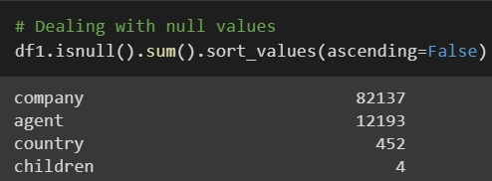
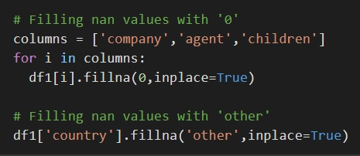
2. Data Cleaning And Manipulation
Dealing with Nan Values : Nan values were present in 4 columns namely company, agent, country and children
Filling Nan values in company and agent with ‘0’
Filling Nan values in country with ‘other’
Filling Nan values in children with ‘0’ . Assuming no children in family that visited the hotel

Slide 8
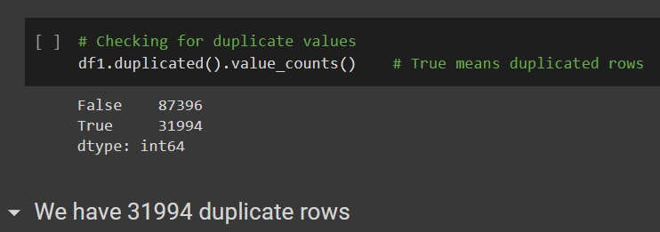

Handling Duplicate Values : Dataset had 31994 duplicate values, so we have dropped these duplicate values
Datetime Object : We have changed datatype of ‘reservation status date’ column to ‘Datetime’ object which was earlier ‘String’ object

Slide 9
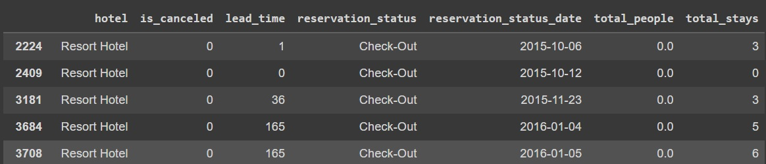

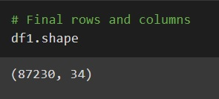
Handling incorrect values : Some wrong entries were made in the dataset as total people leaving in a room were recorded to be 0. So we have dropped these 166 rows
So after doing all the cleaning and manipulations we were left with 87230 rows and 34 columns

Slide 10
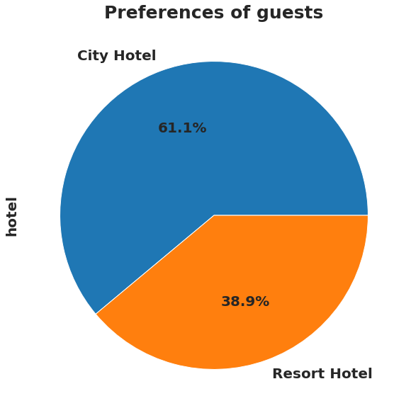
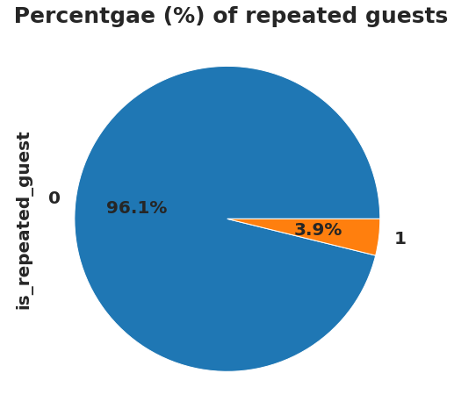
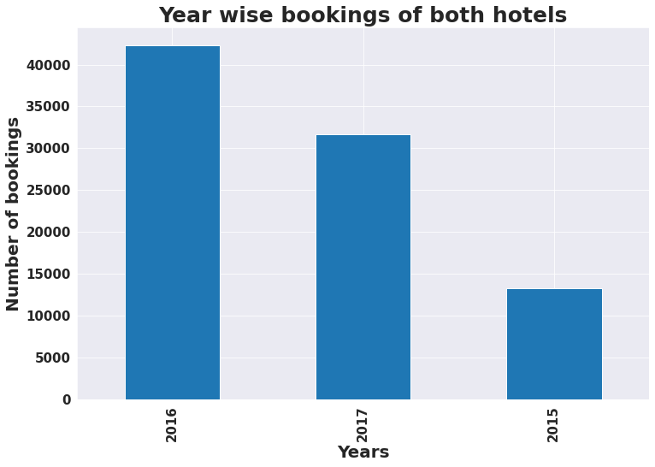
3. Exploratory Data Analysis (EDA)
Lets start with the basic level analysis of the dataset
Observations :
61.1% of guests preferred City hotel and 38.9% of guests preferred Resort hotel. Hence most of the guests preferred City hotel.
96.1% of guests were new guests. Only 3.9% guests revisited the hotel. Thus retention rate is very low for both the hotels.
In 2016 maximum number of guests visited the hotel and 2015 was the worst performing year for the hotels.

Slide 11
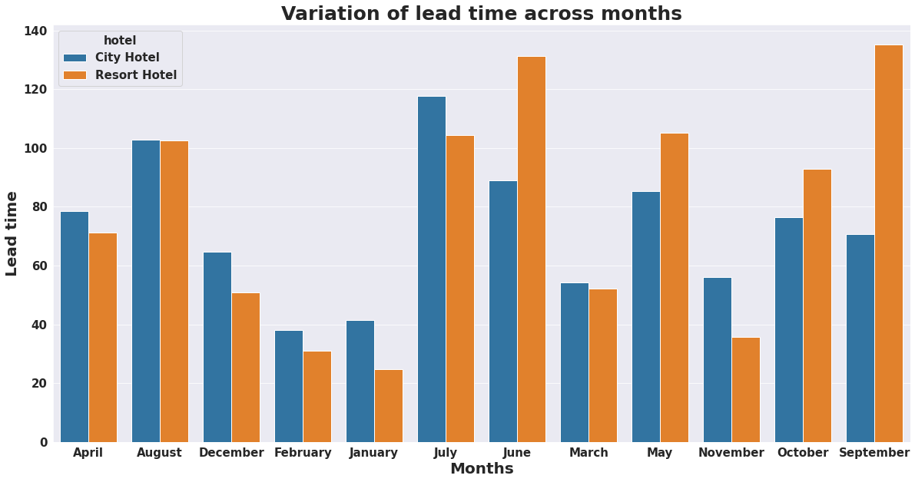
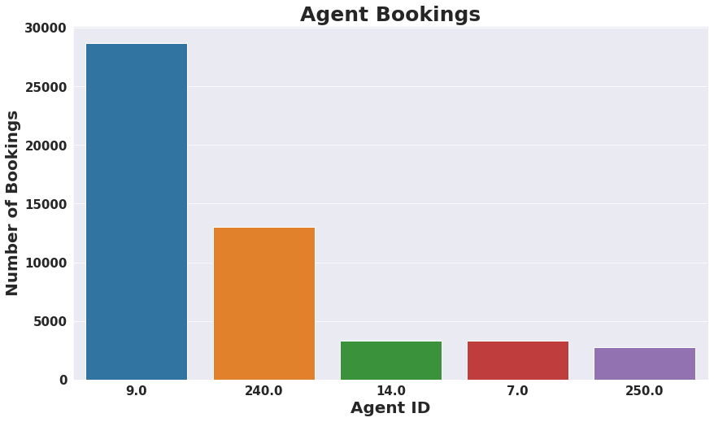
Observations :
City hotel has high lead time in the months of July and August while Resort hotel has high lead time in the months of June and September.
Agent ID 9 has done most number of bookings which is more than 28700.

Slide 12
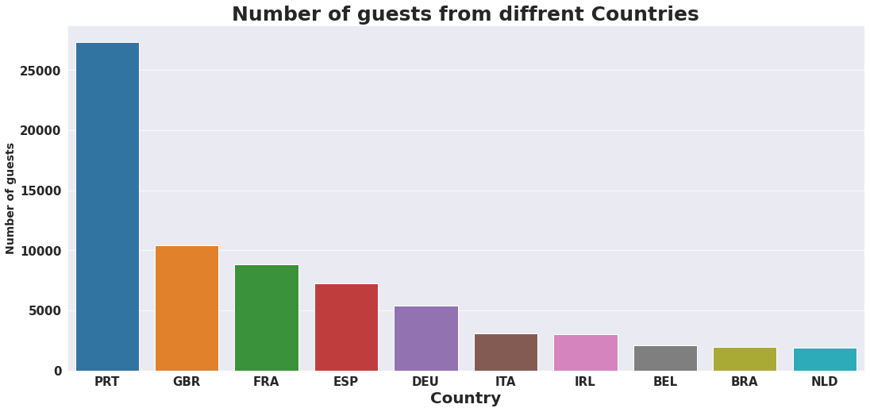
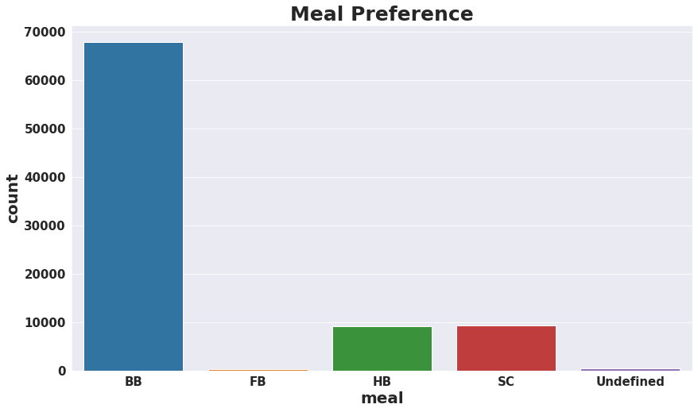
Observations :
Maximum number of guests were from Portugal that is more than 25000.
After Portugal the most number of guests were from Great Britain, France and Spain.
Bed & Breakfast (BB) is the most preferred type of meal by the guests.

Slide 13
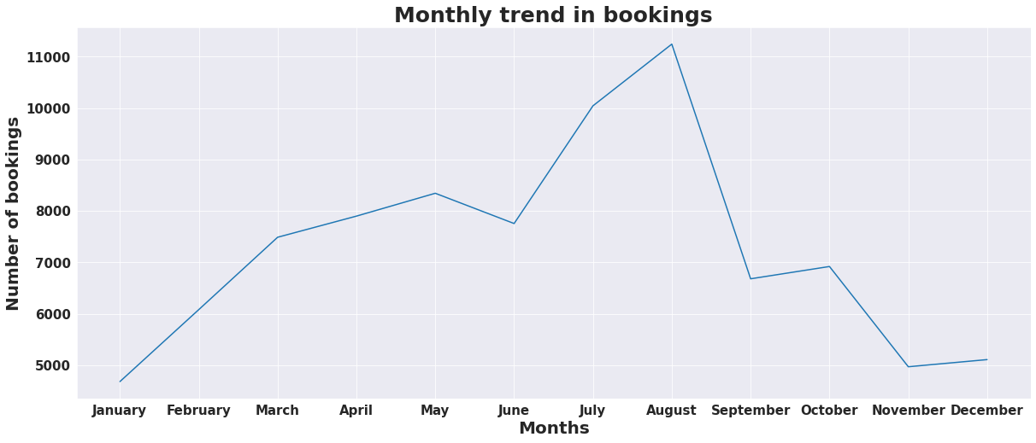
Lets deep dive into our dataset and try to answer some complex questions
Lets understand the trends and main factors affecting the average daily rates (adr) of hotels
Observations :
We can see that the number of bookings steadily increases reaches maximum value and then drastically decreases across months.
July and August were the months where bookings reached their peak values.

Slide 14
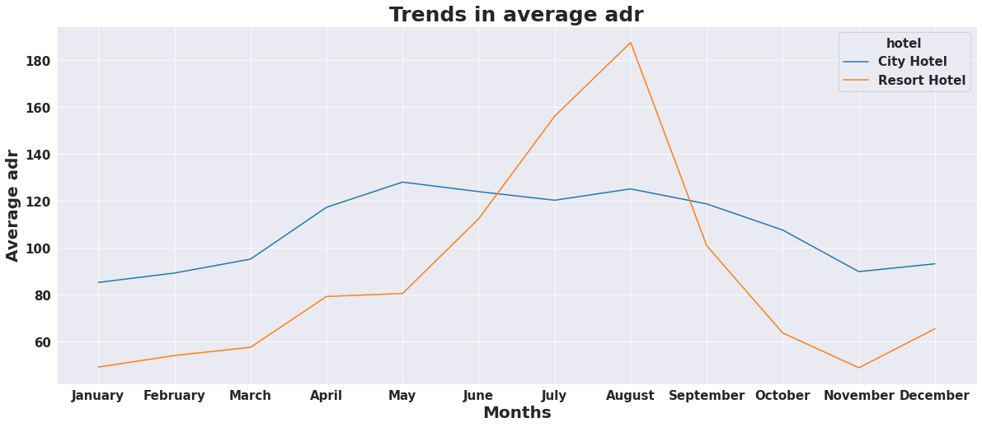
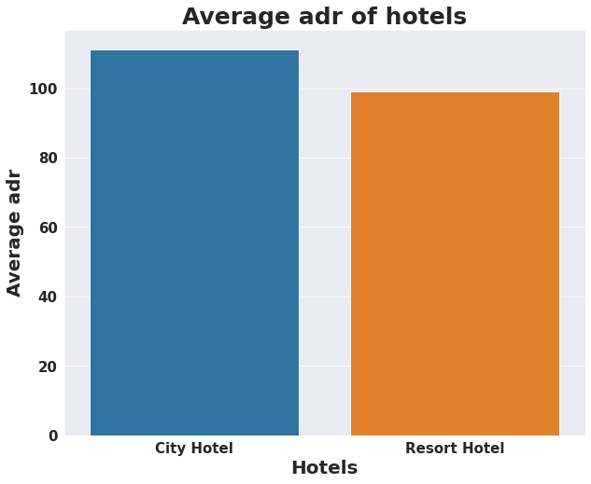
Observations :
City hotel have more or less same average adr across months showing a more consistent performance while Resort hotel show large variation in average adr.
City hotel has the highest average adr in the month of May(128.05) while Resort hotel in the month of August(187.57)
City hotel have high average adr than Resort hotel. Hence City hotel is more profitable as compared to Resort hotel.

Slide 15
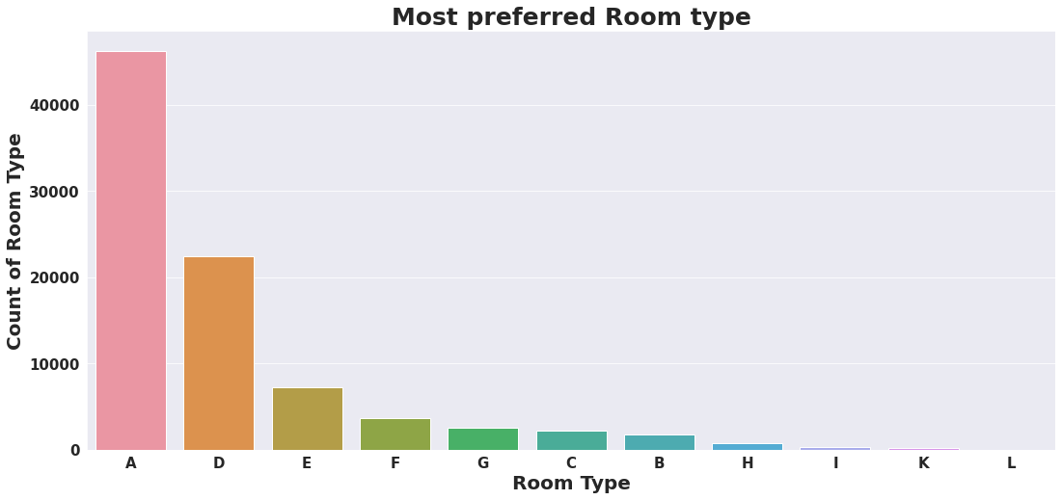
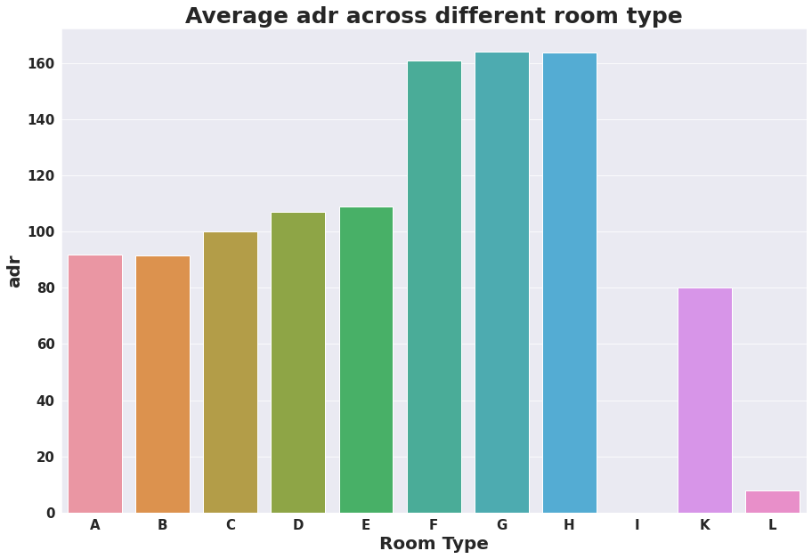
Observations:
A,D,E are most preferred room types by guests.
F,G,H are the rooms with high average adr.
Hence we can say that even though F,G,H are less preferred they are more profitable for hotels. They are like luxury rooms.

Slide 16
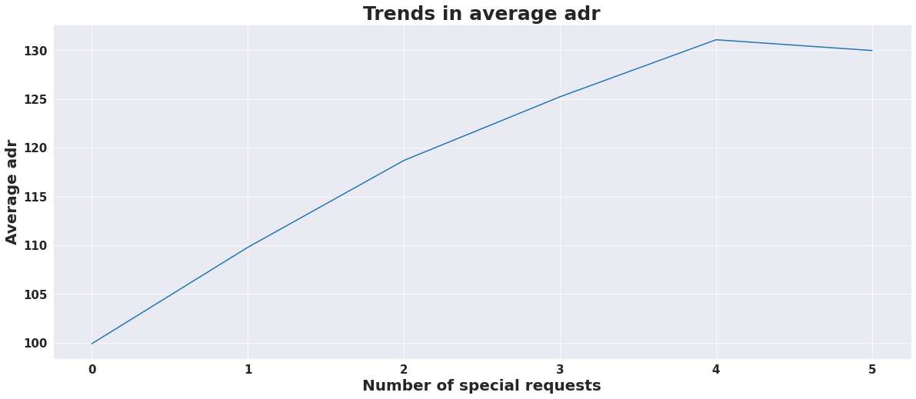
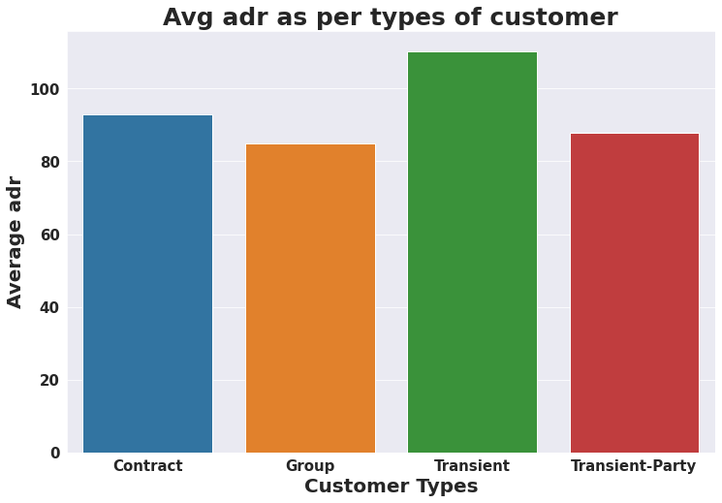
Observations :
We can see that as the number of special requests increases the average adr also increases.
Transient types of guests are spending the most followed by contract type.

Slide 17
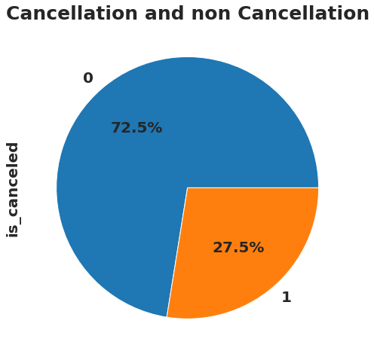
Now lets understand the various patterns behind booking cancellations and its effect on profitability of hotels
Observation : We can see that out of total bookings, 27.5% of bookings were cancelled.

Slide 18
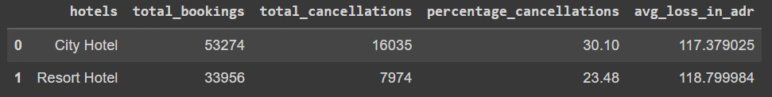
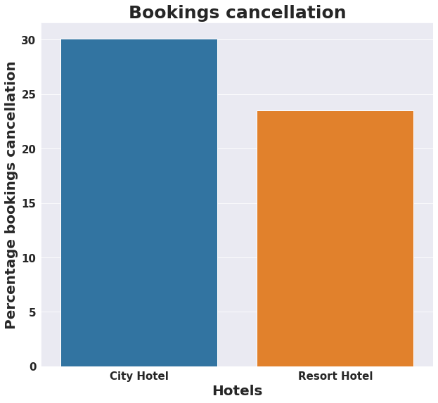
Observations :
City hotel has higher percentage of booking cancellations as compared to Resort hotel.
Average loss in adr due to cancellations for Resort hotel(118.79) is slightly higher than City hotel(117.37).

Slide 19
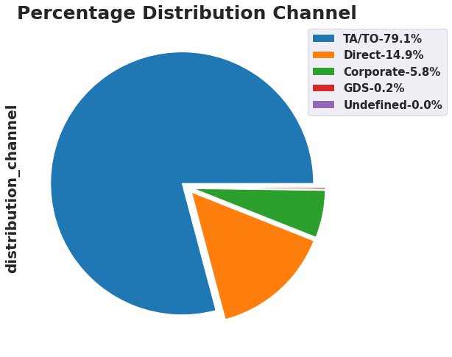
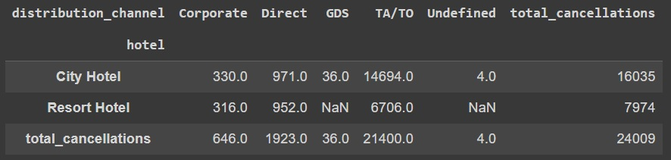
Observations :
79.1% of total bookings were made through TA/TO followed by Direct bookings which is 14.9%
As excepted out of 16035 cancellations for City hotel, 14649 cancellations took place through TA/TO.
Similarly out of 7974 cancellations for Resort hotel 6706 cancellations took place through TA/TO.

Slide 20
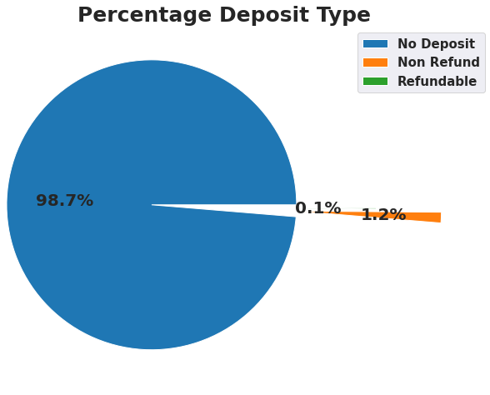
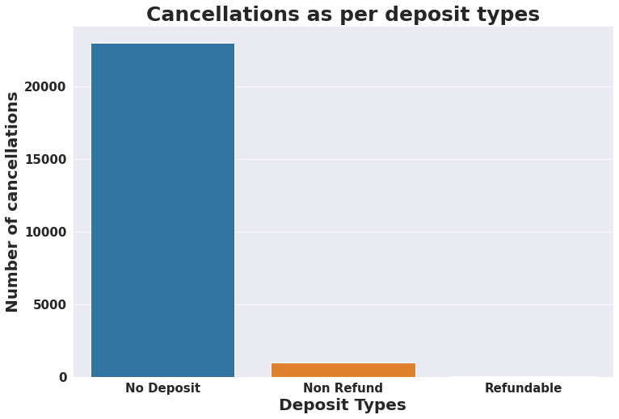
Observations :
We can see that most of the bookings were made through ‘No Deposit’ mode almost 98.7%
Also most of the cancellations were made in ‘No Deposit’ mode.
We can now make a important conclusion that if hotels would have taken some charges for bookings, the cancellations would have decreased drastically.

Slide 21
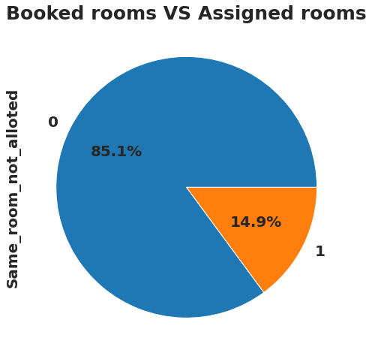
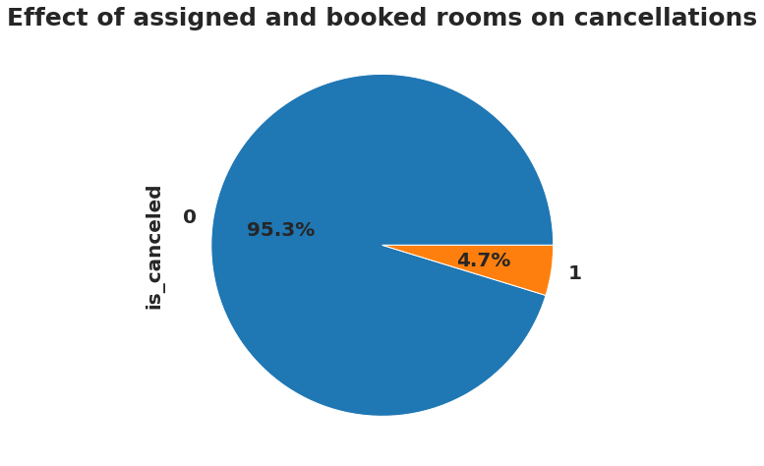
Observations:
We can see that out of total bookings, there were 14.9% bookings where guests were not assigned the same room for which they had made their reservations.
Out of these 14.9% bookings only 4.7% of bookings were cancelled.
Here we can make an important conclusion that not getting the same room as per reserved room is not the reason for booking cancellations.

Slide 22
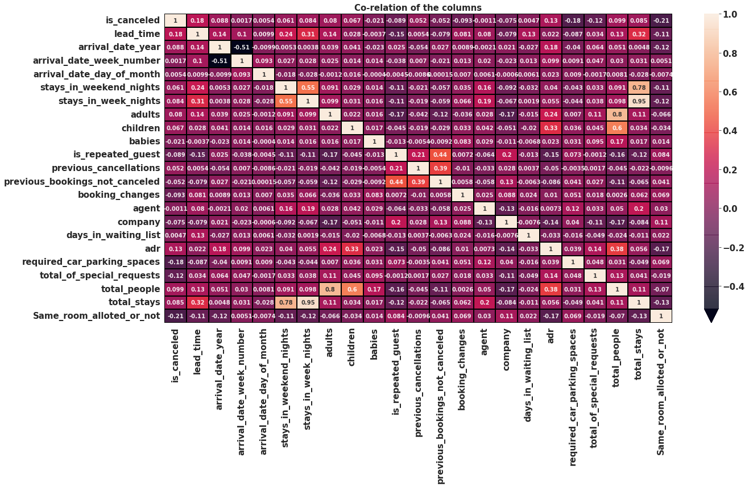
Observations :
lead_time and total_stay is positively correlated hence more the stay more will be lead time.
is_repeated guest and previous_bookings_not_ cancelled has strong correlation, may be repeated guests are not more likely to cancel their bookings.
total_people are positively correlated to adr hence more people more will be adr.

Slide 23
Conclusions:
As the retention rate is low, to increase it hotels can follow different ways such as:-
Dealing with guests issues instantly to increase customer satisfaction.
Excite guests with exclusive packages and deals so they are tempted to visit again.
F, G, H are most profitable room types, so encourage guests to book these rooms by offering special complementary services exclusive to only these rooms.
Hotels can run discount offers and promotions to encourage guests to stay longer, as most customers are transient type and will be scouting for good deals.
Cancellation rate is more since there are no cancellation charges, so having cancellation charges policy may lead to dip in cancellation of bookings in both hotels.
Hotels can minimize TA/TO cancellations by having a lower commission for TA/TO with higher cancellations.

Slide 24
THANK YOU

